Slide 1

Convolutional Neural Networks
Pooling layers
deeplearning.ai

Slide 2
Pooling layer: Max pooling
1 | 3 | 2 | 1
2 | 9 | 1 | 1
1 | 3 | 2 | 3
5 | 6 | 1 | 2

Slide 3
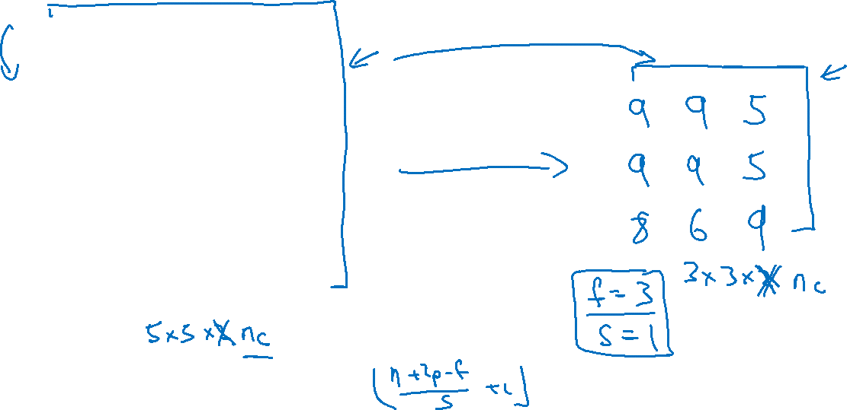
Pooling layer: Max pooling
1 | 3 | 2 | 1 | 3
2 | 9 | 1 | 1 | 5
1 | 3 | 2 | 3 | 2
8 | 3 | 5 | 1 | 0
5 | 6 | 1 | 2 | 9

Slide 4
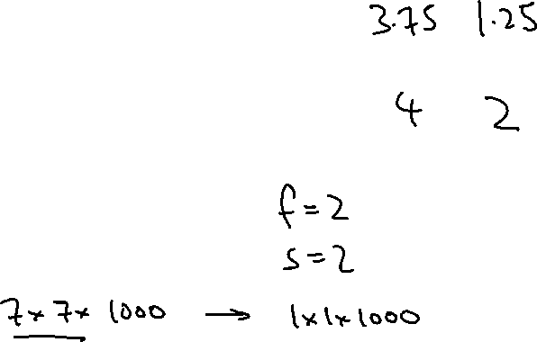
Pooling layer: Average pooling
1 | 3 | 2 | 1
2 | 9 | 1 | 1
1 | 4 | 2 | 3
5 | 6 | 1 | 2

Slide 5
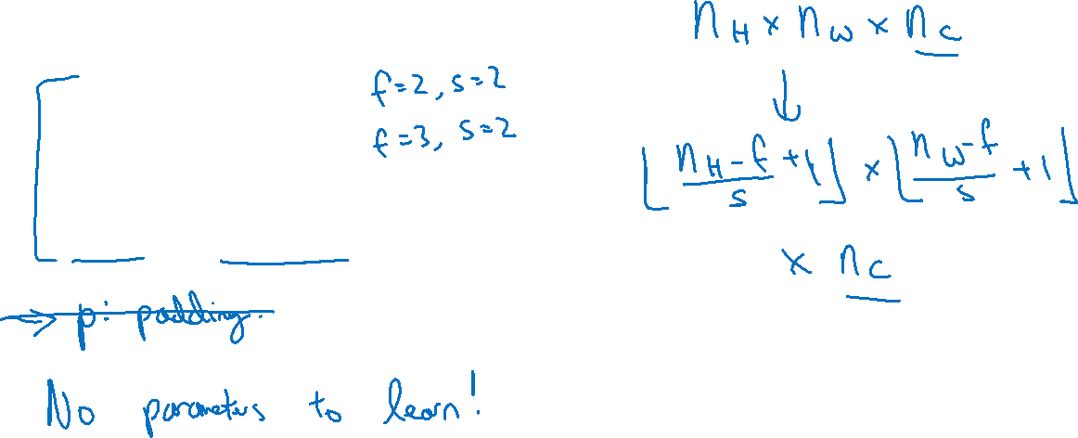
Summary of pooling
Hyperparameters:
f : filter size
一般取值：
s : stride
Max or average pooling

